Slide 1



Skin-SOAP: Weakly Supervised Multimodal Framework for Structured SOAP Notes
Sadia Kamal · Tim Oates · Joy Wan
University of Maryland Baltimore County
Johns Hopkins University School of Medicine
Notes:
Hello everyone, I am Sadia Kamal, a Ph.D. student in Computer Science. Today, I will be presenting Skin-SOAP, a weakly supervised multimodal framework for structured SOAP notes in dermatology. This is joint work with my advisor, Dr. Tim Oates, in collaboration with Dr. Joy Wan, a dermatologist at the Johns Hopkins University School of Medicine.

Slide 2
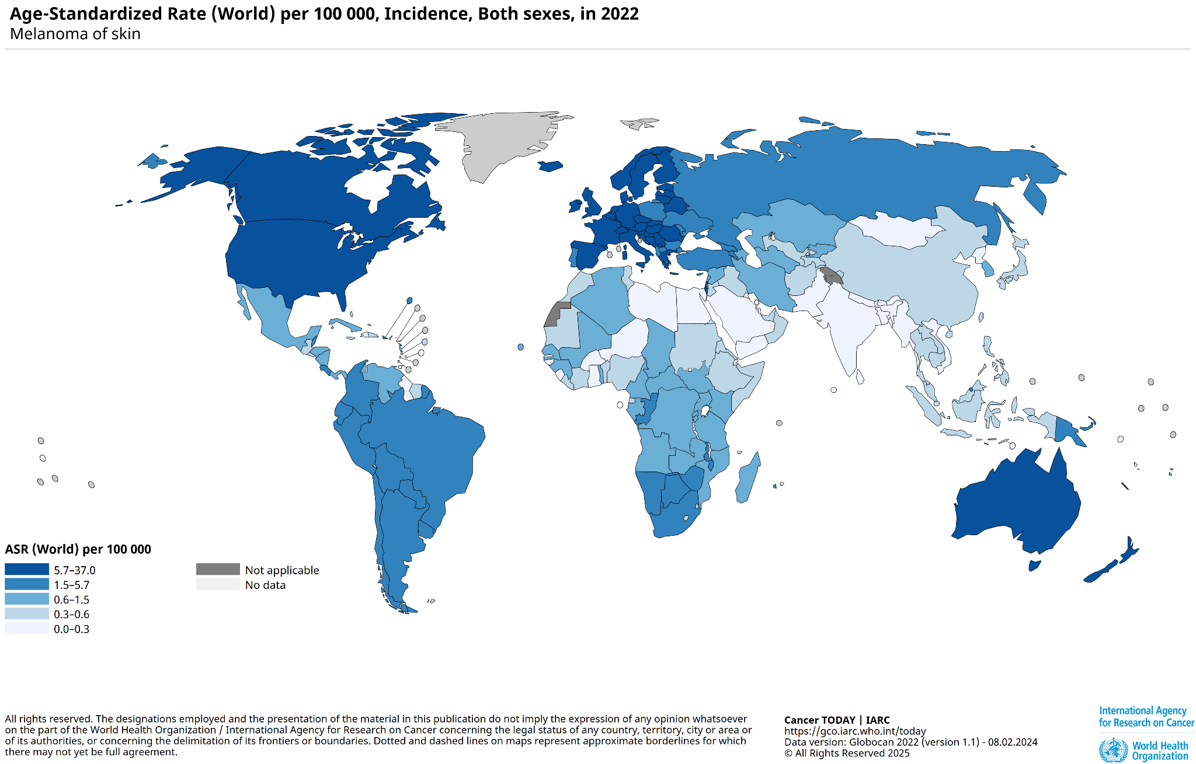
Intro
Skin cancer: ~9,500 new U.S. cases daily → urgent need for efficient documentation.
Subjective, Objective, Assessment and Plan (SOAP) notes: Standard format for accurate clinical communication.
Manual note-taking is slow, burdensome, causes physician burnout and less doctor patient interaction.
Existing methods need large annotated datasets or recorded doctor patient conversation which is scarce in dermatology.
Skin-SOAP: weakly supervised, multimodal framework using lesion images + sparse text with retrieval-augmented knowledge.
Novel metrics: MedConceptEval & Clinical Coherence Score to assess clinical and semantic quality.
Notes:
Skin cancer is a major health concern, with around 9,500 new cases diagnosed daily in the U.S. SOAP notes — Subjective, Objective, Assessment, and Plan — are the standard format for clinical communication.
Why are we doing this: Manual note-taking is time-consuming, leading to physician burnout and reduced doctor–patient interaction.
Limitation: Existing AI methods rely heavily on large annotated datasets, which are rarely available in dermatology, or on complete recorded doctor–patient conversations, which can be cumbersome and burdensome.
Skin-SOAP, however, offers a solution for limited data by combining lesion images with sparse structured data to generate clinically relevant SOAP notes. We also developed novel evaluation metrics — MedConceptEval and CCS — to assess the clinical and semantic quality of the generated notes.

Slide 3
Dataset and Preprocessing
Dataset
This data is collected from PAD-UFES-20, which is
2,298 dermoscopic images from 1,641 lesions (1,373 patients).
6 lesion types: BCC, MEL, SCC, ACK, SEK, NEV.
Each lesion linked to 26 structured clinical features.
Preprocessing
From a cohort of 1,373 patients with structured clinical features, we selected those features most useful for our study.
Converted structured features into coherent lesion descriptions using GPT-3.5.
Notes:
The dataset is collected from PAD-UFES-20, that contains 2,298 dermoscopic images from 1,641 lesions in 1,373 patients, covering 6 lesion types. In this Each lesion is linked to 26 structured clinical features — like size, location, symptoms, demographics, history). We first selected features that are useful for our study then we transformed these structured features into coherent lesion descriptions using GPT-3.5, which allowed us to generate natural-sounding captions while preserving medical detail.

Slide 4
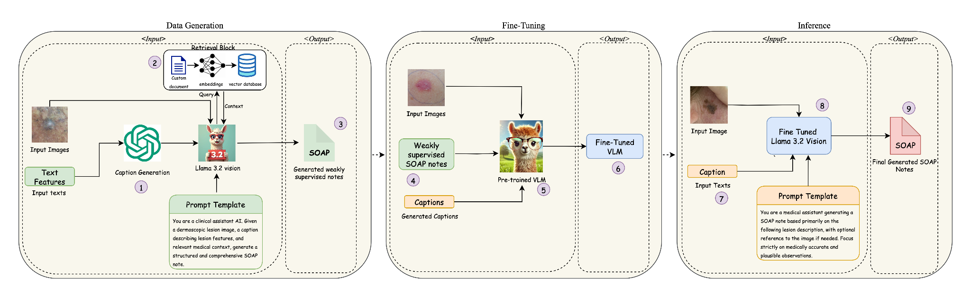
Method Overview
Skin-SOAP is a three-phase weakly supervised multimodal framework for generating clinically structured SOAP notes from limited dermatologic inputs.
Notes:
Skin-SOAP’s workflow has three phases: data generation, fine-tuning, and inference.

Slide 5
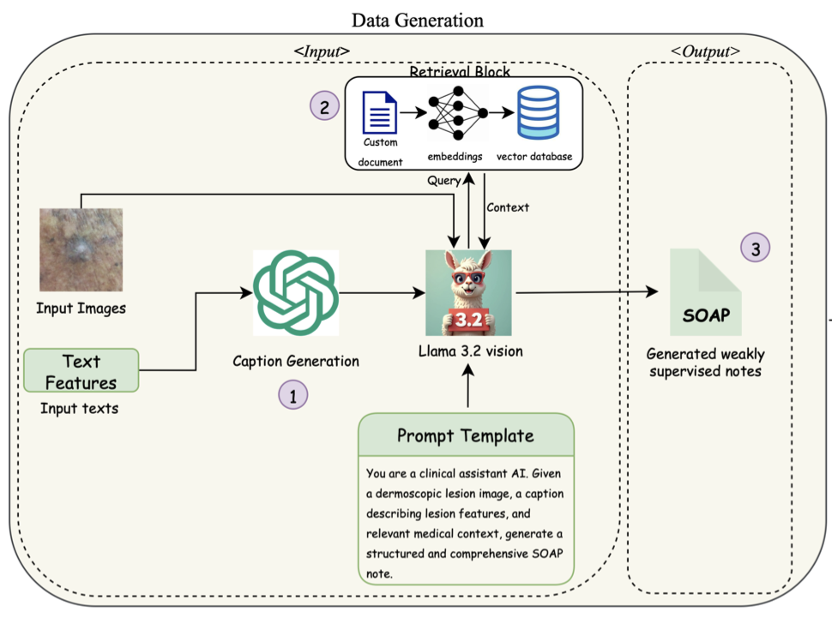
Phase 1: Data Generation
From structured clinical features, captions are generated via GPT-3.5.
We used Retrieval-Augmented Generation that retrieve specific context from vector database (collected from trusted medical sources).
Inputs: Lesion image, caption and retrieved context.
Vision-LLaMA 3.2 generates weakly supervised SOAP notes via structured prompt.
Notes:
In Phase 1, we take structured clinical features and turn them into captions with GPT-3.5 as shown as 1.
We then use retrieval-augmented generation to pull relevant context from a document which is curated from different medical sites and stored in a vector database.
The lesion image, generated caption, and retrieved context are fed into Vision-LLaMA 3.2, which outputs synthetic SOAP notes.

Slide 6
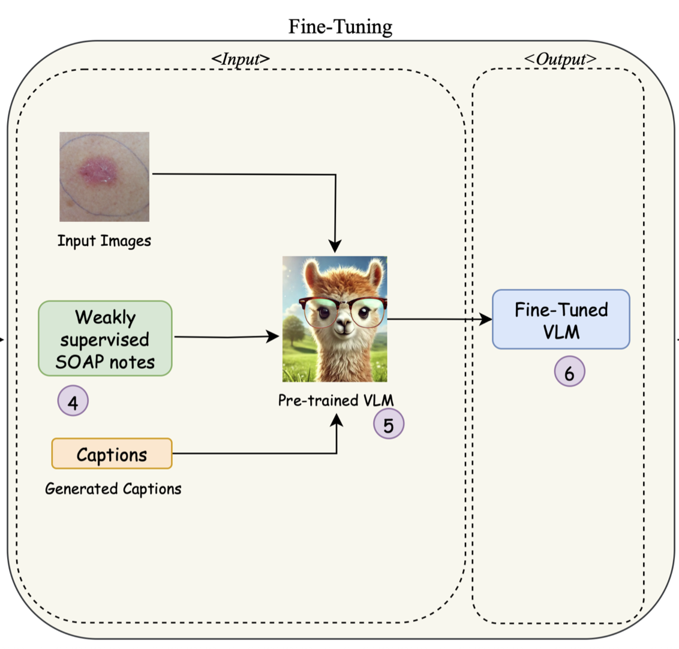
Phase 2: Fine Tuning
Fine Tuned Vision-LLaMA 3.2 on synthesized dataset with input (Lesion image + caption + SOAP).
Training Setup
QLoRA settings: rank = 8, α = 16, no dropout.
Batch size: 8; gradient accumulation = 4; 500 epochs.
Optimizer: AdamW, 8-bit precision; bf16 mixed precision.
Hardware: NVIDIA A100 (80 GB VRAM).
Runtime: Data generation ~9 hrs; Fine-tuning ~1.5 hrs.
Notes:
"Phase 2 is fine-tuning.
We use the synthetic dataset from Phase 1, We used lesion images, captions, and SOAP notes, to fine-tune Vision-LLaMA 3.2 using QLoRA for efficiency.
Training settings: rank 8, alpha 16, no dropout, batch size 8, gradient accumulation 4, and 500 epochs. We trained on an NVIDIA A100, and fine-tuning took about 1.5 hours."

Slide 7
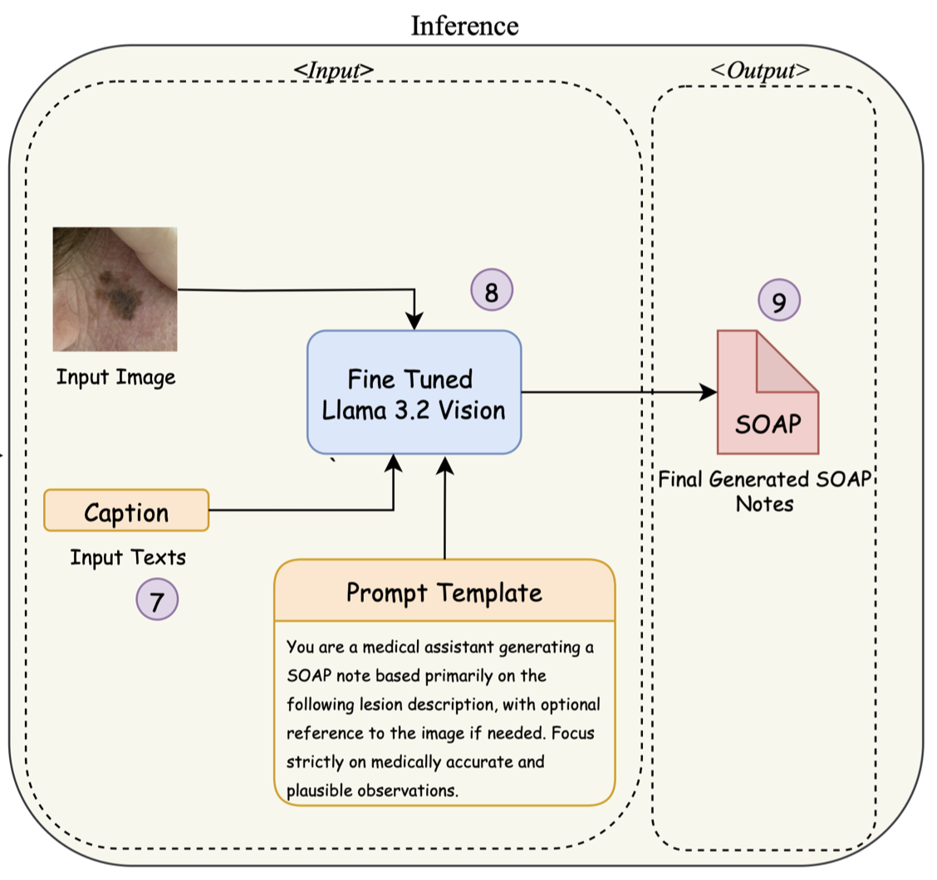
Phase 3: Inference
New lesion images and its related clinical features are transformed into a clinical caption.
Input: Image and Caption fed into fine-tuned Vision-LLaMA.
Model outputs a structured SOAP note.
Notes:
In Phase 3, we feed new lesion images and their structured features into the pipeline.
The features are converted into captions, then combined with the image as input to the fine-tuned model.
The output is a structured SOAP note, which is then evaluated for semantic alignment using clinically validated concept sets.

Slide 8
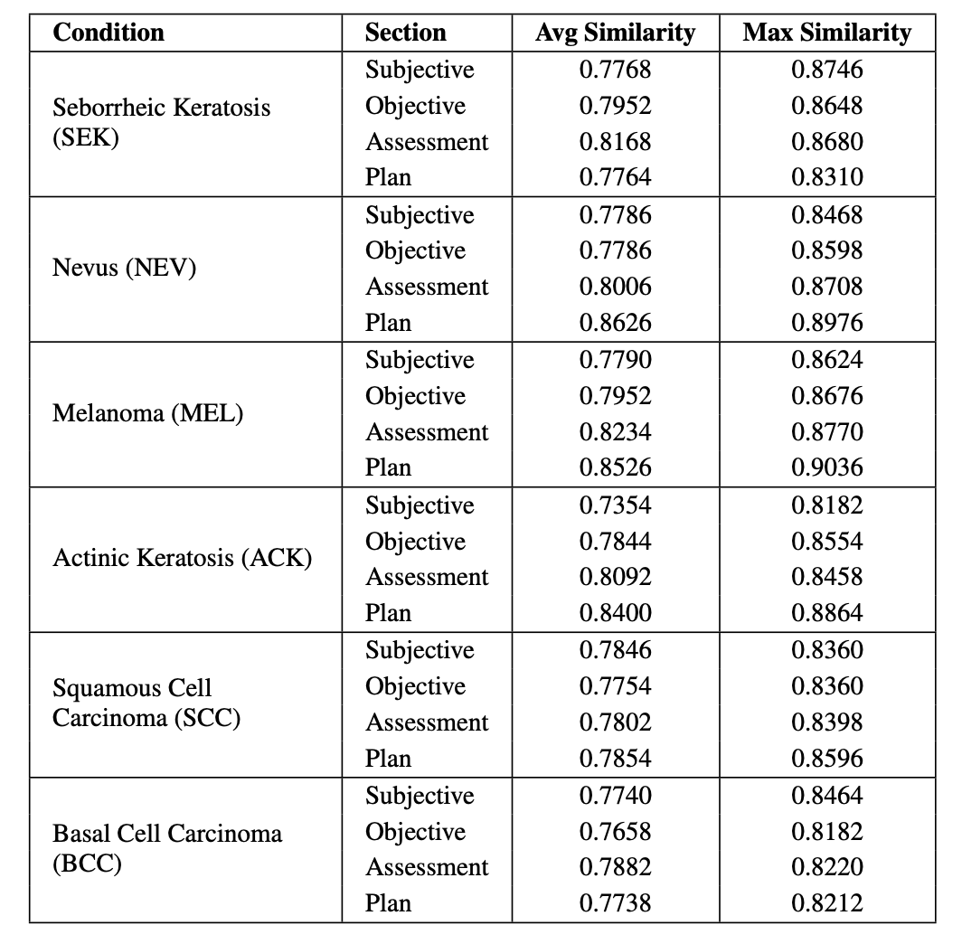
Quantitative Evaluation – MedConceptEval
Measures semantic alignment of each SOAP section with clinically validated concept sets (descriptor banks) for 6 dermatological classes.
Statistical analysis (Two-Way ANOVA):
Significant effect of SOAP section (p = 0.022).
No significant effect of lesion type (p = 0.268) therefore, consistent performance across conditions.
Notes:
MedConceptEval measures how well each SOAP note section aligns semantically with clinical concept sets collected from various medical sources, covering six dermatological classes. This table shows the MedConceptEval results in which The ‘Average Similarity’ column represents the mean cosine similarity across test cases, while ‘Max Similarity’ shows the highest observed alignment for each section. We see consistently high similarity scores — generally in 0.77 to 0.86 range — with some Plan sections reaching over 0.90, especially for Melanoma and Nevus.
We also did statistical analysis using a two-way ANOVA found a significant effect of the SOAP section, with a p-value of 0.022, indicating that certain sections, like Assessment and Plan, tend to align better with clinical concepts than others.
Most importantly, this 2 way ANOVA shows there was no significant effect of lesion type, with a p-value of 0.268. This tells us the model performs consistently across all six dermatological conditions, without being biased toward any particular class.

Slide 9
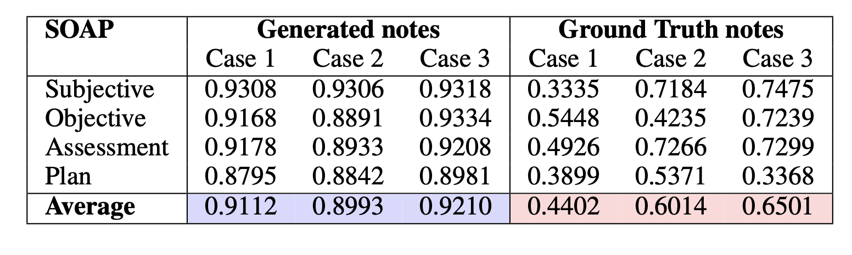
Quantitative Evaluation – Clinical Coherence Score (CCS)
Measures semantic alignment between caption and each SOAP note section.
Statistical Analysis (Two-Way ANOVA):
Significant effect of note type (p < 0.001) → Model > Human in semantic alignment.
No significant difference across SOAP sections (p = 0.254) → Consistent coherence.
Notes:
Similarly the table at the bottom presents the Clinical Coherence Score results, which measure how well each SOAP section aligns semantically with the caption, comparing our generated notes against the ground truth notes for three lesion cases.
The generated notes show consistently high alignment scores compared to the ground truth notes score which is considerably lower. From this We can say that Our model excels at matching caption terminology due to its training setup, but still lacks the depth and nuanced reasoning found in clinician-written notes,highlighting the need for future work to bridge this gap.
We also did Statistical analysis using a two-way ANOVAfor this, which revealed a significant effect of note type, with a p-value less than 0.001, confirming that our model significantly outperforms humans in semantic alignment.
There was no significant difference across the four SOAP sections, with a p-value of 0.254, meaning our model maintains consistent coherence regardless of which SOAP sections

Slide 10
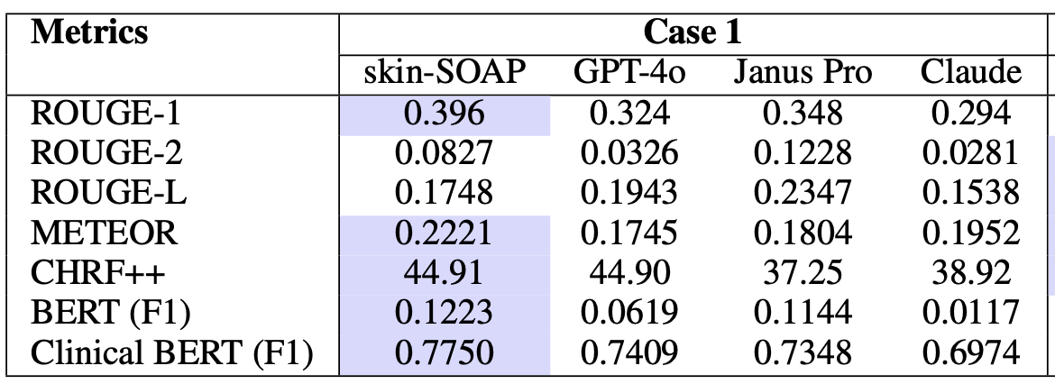
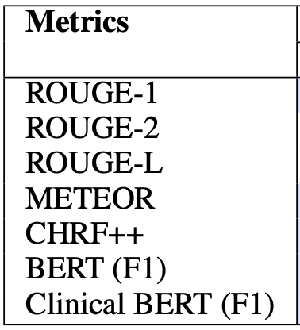
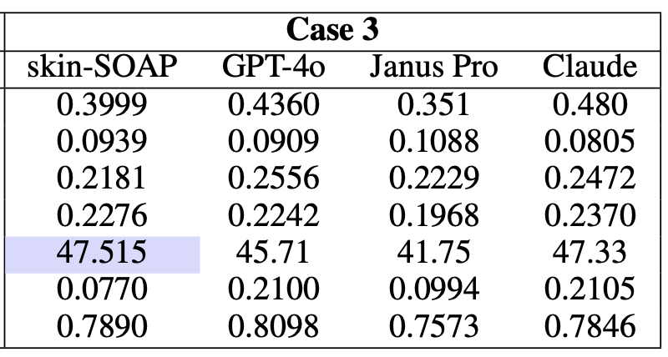
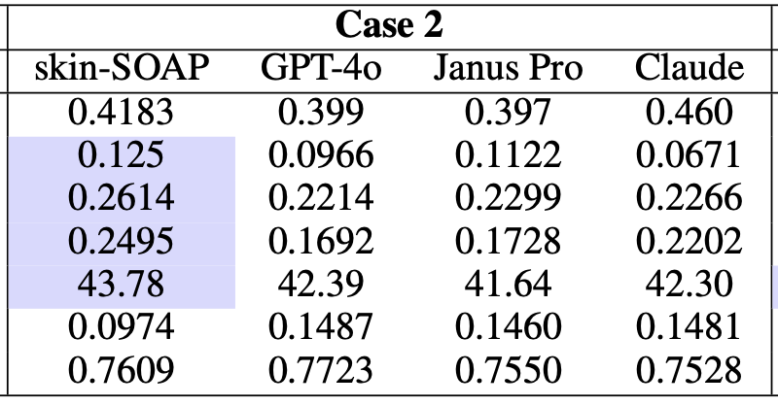
Quantitative Evaluation Metrics
Notes:
These table shows the evaluation of generated SOAP notes across a range of metrics — lexical similarity metrics like ROUGE and METEOR, character-level metric CHRF++, and semantic similarity metrics using both general BERT and Clinical BERT embeddings.
Across all three cases, our approach, Skin-SOAP, consistently performs competitively and often leads in key clinical metrics. For example, in Case 1, we achieve the highest Clinical BERT F1 score at 0.7750, indicating strong alignment with clinically relevant terminology. In Cases 2 and 3, we maintain similarly high Clinical BERT scores of 0.7609 and 0.7890, outperforming models in clinical semantic similarity.
We also see strong results in lexical measures like ROUGE-L and METEOR, with our scores being consistently among the top performers. CHRF++ values are also competitive, peaking at 47.515 in Case 3

Slide 11
Qualitative Evaluation
We used Flow-Judge-v0.1 for 5 point scale criteria:
Structure
Readability
Completeness
Medical Relevance
Results:
Skin-SOAP: 20/20 perfect score.
Baselines (GPT-4o, Claude, Janus Pro): 18–19/20.
Our model excelled in organization, accuracy, and completeness.
Delivers higher clinical fidelity and completeness than SOTA baselines.
Notes:
We used Flow-Judge-v0.1, highest-rated open-source evaluator on hugging face leaderboard. We used this to evaluate structure, readability, completeness, and medical relevance on a 5-point scale.
In these Skin-SOAP achieved a perfect score — 20/20 — surpassing baselines like GPT-4o, Claude, and Janus Pro.

Slide 12
Conclusion
Skin-SOAP delivers a scalable, weakly supervised solution for structured dermatology SOAP note generation.
Seamlessly combines caption generation, retrieval-augmented knowledge, and Vision-LLaMA fine-tuning.
Minimizes need for extensive expert annotation while ensuring high clinical relevance and structural accuracy.
Demonstrated strong performance through quantitative metrics and LLM-as-a-Judge evaluations.
Promising pathway toward efficient, reliable, and scalable AI-assisted medical documentation.
Notes:
To conclude, Skin-SOAP offers a scalable, weakly supervised solution for structured dermatology SOAP note generation.
By combining caption generation, retrieval-augmented knowledge, and fine-tuned multimodal models, we minimize the need for large expert-annotated datasets while ensuring high clinical relevance and structure.
This work shows strong potential for efficient, reliable, and scalable AI-assisted medical documentation."

Slide 13
Limitations and Future Work
Limitations
Dependent on accuracy of retrieved clinical knowledge → possible bias/incomplete info.
Single dataset used; metadata variation limits generalization.
Small expert-annotated set for evaluation.
Risk of hallucinations with ambiguous/unfamiliar inputs.
Future Work
Expand to diverse, multi-source datasets to improve robustness.
Incorporate human-in-the-loop refinement for enhanced accuracy.
Strengthen safeguards for real-world clinical deployment.
Notes:
Limitations include dependency on retrieved knowledge — which could introduce bias — and reliance on a single dataset, which limits generalization.
The evaluation set was small with fewer expert-annotation, and hallucinations may occur with ambiguous inputs.
Future work will expand to diverse datasets, integrate human-in-the-loop review, and add safeguards for deployment in real-world clinical settings."

Slide 14

ThankYou!
Questions?
Notes:
Thank you for your attention

